Slide 1
Camunda. Overall architecture solutions.

Slide 2
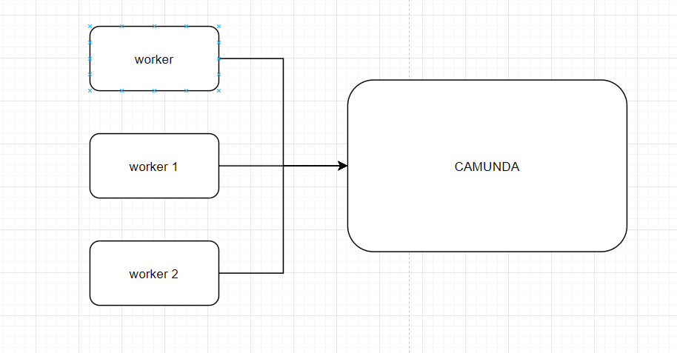
@Slf4j @Component @ExternalTaskHandlerAnnotation(topicName = “test_topic_name", lockDuration = 300) public class ClassHandler extends AbstractHandlerWithBusinessInstanceSupport { @Override public void execute(ExternalTask task, ExternalTaskService service, BusinessInstanceDTO instance) throws Exception { Map<String, Object> vars = new HashMap<>();
(……………… some business logic) vars.put(“Key1", Boolean.TRUE); vars.put(“Key2", “Some string value"); service.complete(task, vars);
}
}

Slide 3
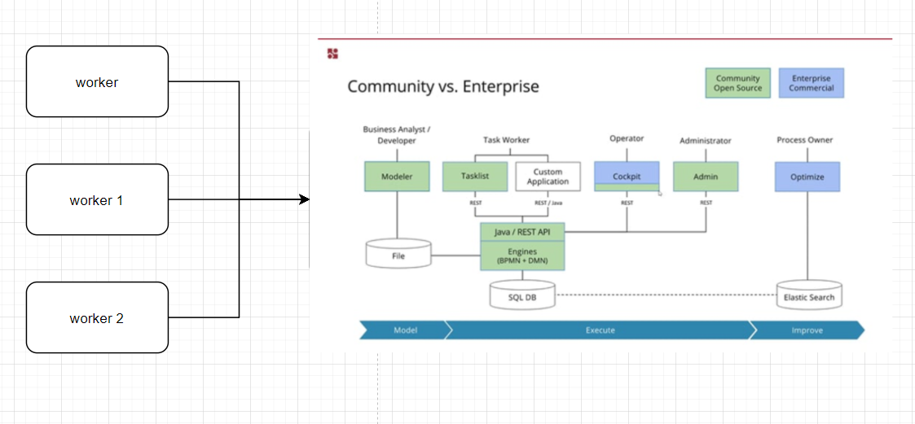

Slide 4
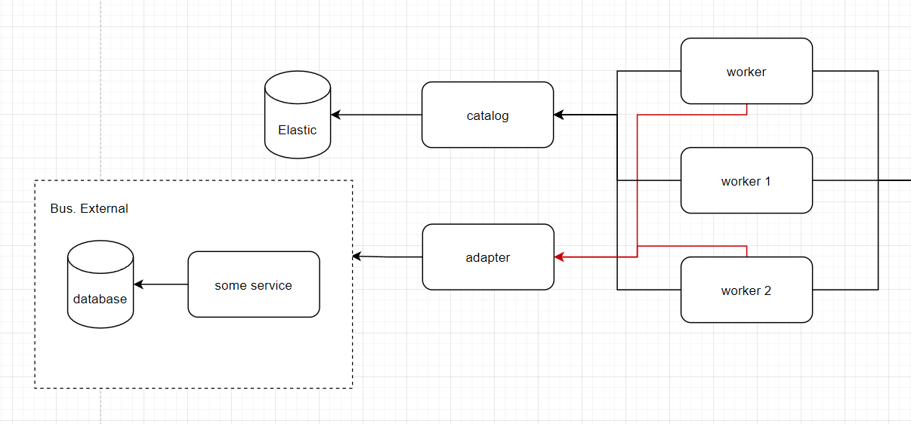

Slide 5
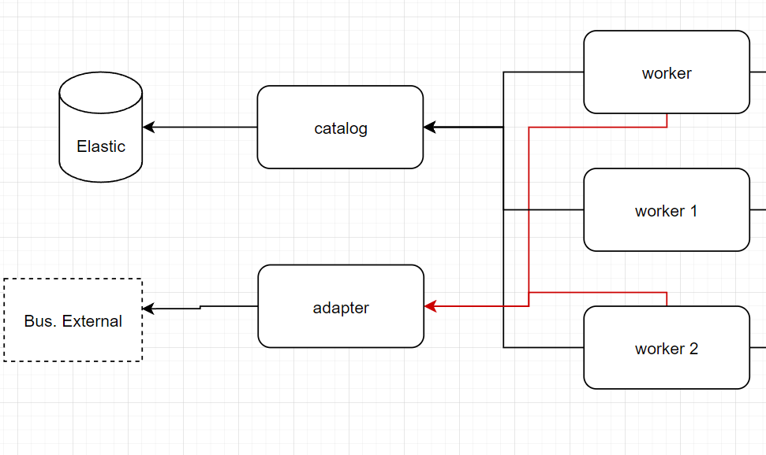

Slide 6
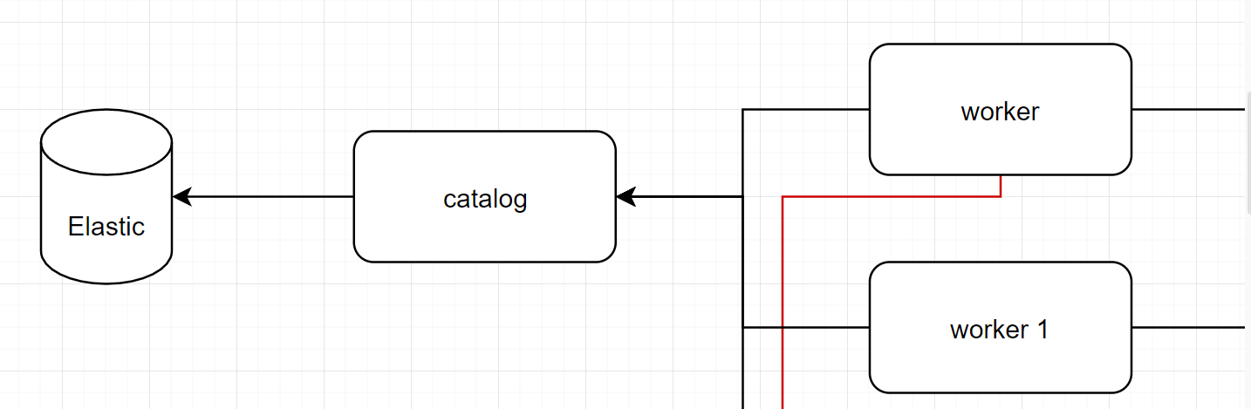
@FeignClient(name = “catalog”) public interface ServiceFeignClient { @GetMapping(“/users/${id}/statistic”) public List<UserStatisticModel> getStatistic(@PathVariable String id); }
???
@Service public class UsersServiceImpl implements UsersService { @Autowired ServiceFeignClient serviceFeignClient; …. List<AlbumResponseModel> albumsList = serviceFeignClient.getStatistic(userId); …. }
@RestController @RequestMapping(“/users/{id}/statistic”) public class StatisticsController { @Autowired StatisticsService statisticsService; public List<UserStatisticModel> getStatistic(@PathVariable String id) { List<UserStatisticModel> statisticsList = statisticsService.getAlbums(id); return statisticsList; } }

Slide 7
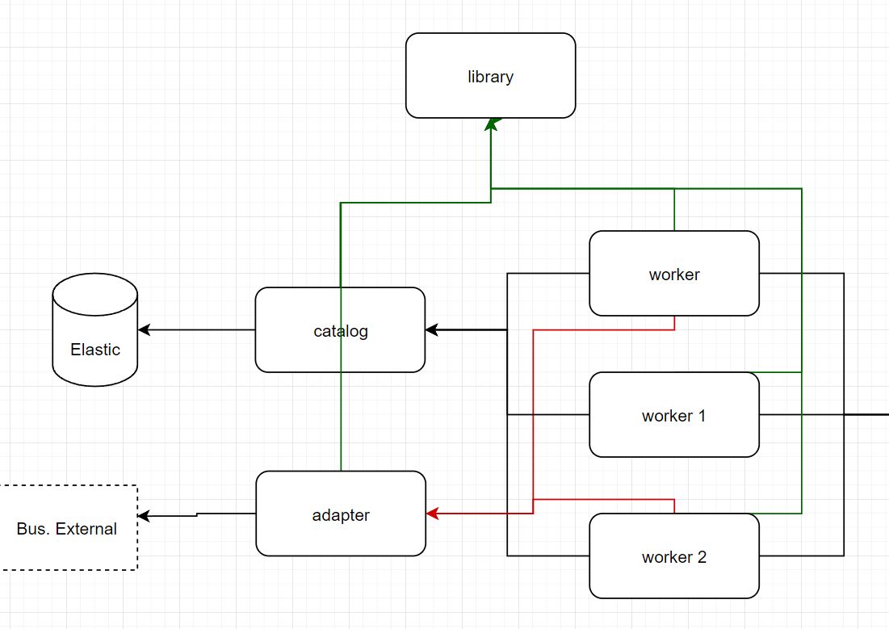
@FeignClient(name = “library”) public interface ServiceFeignClient { @GetMapping(“/users/${id}/statistic”) public List<UserStatisticModel> getStatistic(@PathVariable String id); }
@Data @AllArgsConstructor @NoArgsConstructor @Builder public class UserStatisticModel { @JsonProperty("additional_info") private String additionalInfo; //Доп информация @JsonProperty("operation_id") private String operationId; //Номер операции @JsonProperty("client_name") private String clientName; //ФИО
…………………

Slide 8
Technologies/Plugins you should know:
Git (https://git-scm.com/doc) (merge/push/resolve conflict/merge commit etc.)
Lombok (https://www.baeldung.com/intro-to-project-lombok )
Jackson (https://www.baeldung.com/jackson )
Junit 5 + TestMe (https://www.baeldung.com/junit-5 + https://plugins.jetbrains.com/plugin/9471-testme )
SonarLint (https://plugins.jetbrains.com/plugin/7973-sonarlint + https://www.sonarlint.org/ )
SonarQube.
CI/CD. Pipelines.
Maven (https://javarush.ru/groups/posts/2523-chastjh-4osnovih-maven )
Elasticsearch (https://www.elastic.co/guide/index.html + https://www.baeldung.com/spring-data-elasticsearch-tutorial )
Postman (https://www.postman.com/ )
Database + postgresql
Spring
Camunda
Java 17
Spring cloud (netflix)

